Slide 1
Encrypted Password Manager
By: Vincent Faragalli

Slide 2
The Project: Our Encrypted Password Manager
The Evolution of Cryptography
01
03
02
04
Password Manager Research
Conclusion
Project Scope: 1) Research on Encryption & Password Managers
2) Implementing a Secure Password Manager
Cipher Classification, Caesar Cipher, Vigenere Cipher, Data Encryption Standard, RSA, Advanced Encryption Standard
Video demo, screenshots, etc
Existing password managers and their strengths, weaknesses, and security incidents (if occured
Challenges, what we learned, for the future, and resources

Slide 3
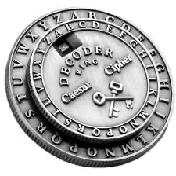
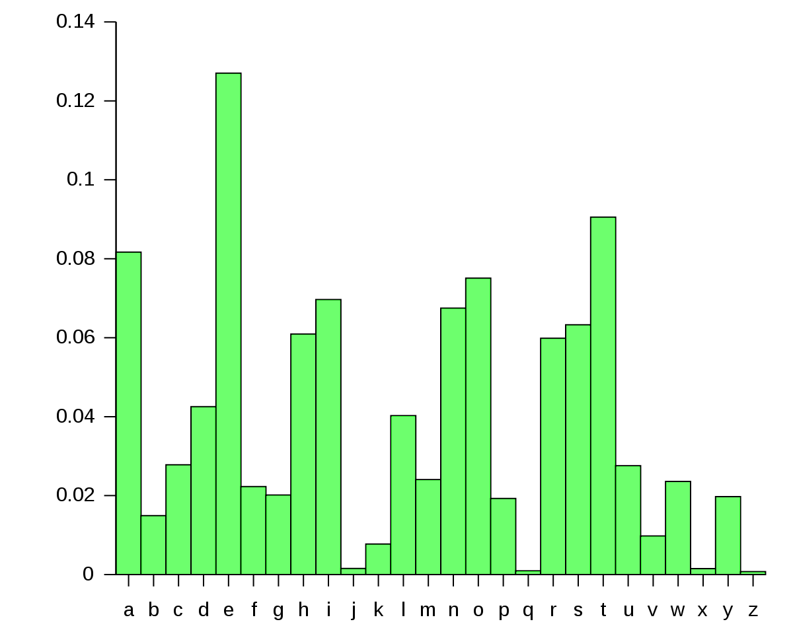
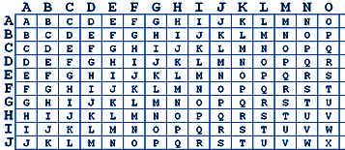
The Evolution of Cryptography
hidden
writing
Caesar Cipher (~100 BC)
What
Substitution Cipher // takes 1 key value and shifts the alphabet by the key value
Why
Rome expansion, conquest, & war messaging
Next Steps
Step away from monoalphabetic ciphers // the need to start using more than 1 alphabet
Vigenere Cipher (16th century)
What
Polyalphabetic cipher, 26 X 26 alphabet matrix, keyword key,
Why
Italy delving into the study on cryptography
Next Steps
Stepping away from alphabetical ciphers altogether
Security Vulnerabilities:
Brute force
Frequency Analysis (cannot be used unconditionally)

Slide 4
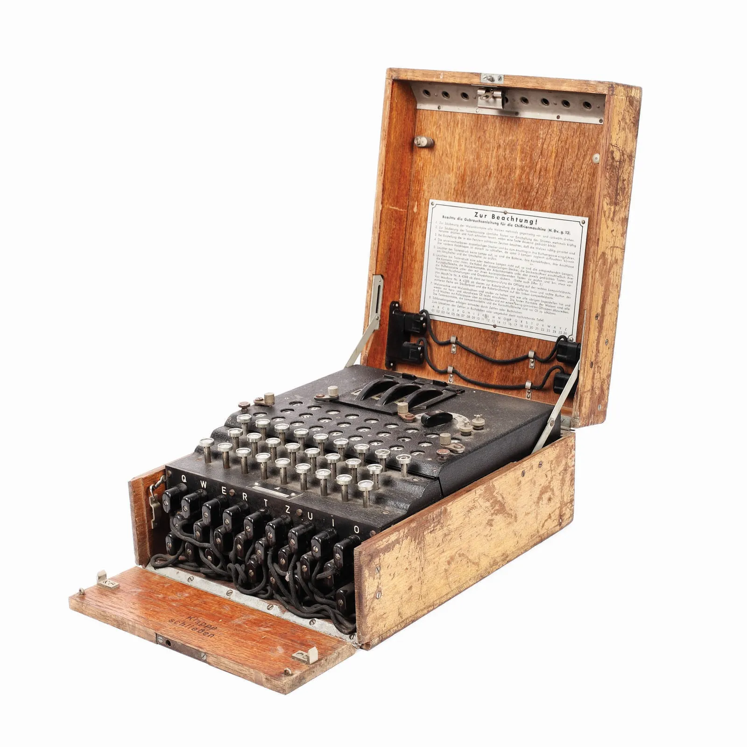
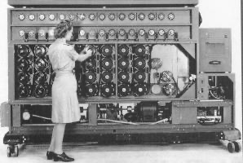
The Evolution of Cryptography
Enigma (1918)
Data Encryption Standard || DES (1970s)
What
A key is pressed, electrical signals pass through rotors, scrambling the input letters. Each day the encryption scheme was changed
Why
Used in German military during World War ||
What
Multi-dimensional encryption using multiple rounds of permutation & substitution would provide diffusion & confusion
Why
Develop secure communication and data protection for government, finance, and telecommunications
Next Steps
Larger key sizes which would then decrease ability to use brute force attacks
Diffie Hellman Key Exchange (1976)
What
2 parties can establish a shared secret key by obtaining a private key and sharing both public keys
Why
Create an alternative to private key sharing
CRACKED

Slide 5
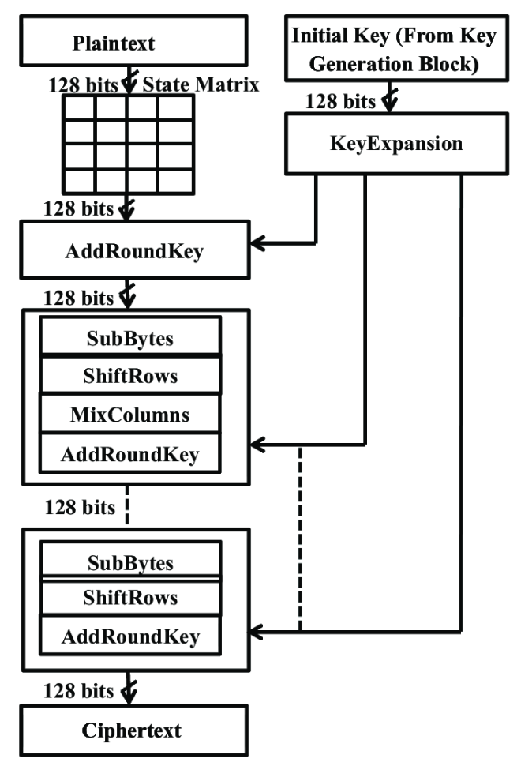
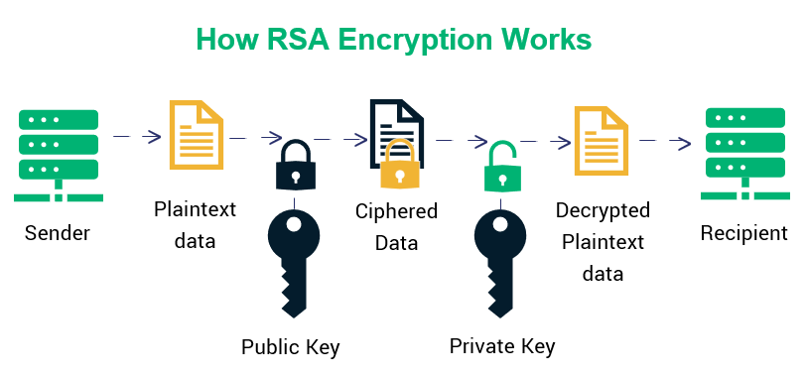
The Evolution of Cryptography
1001010100110010100010100010101011001001111001010101010100110
RSA (1977)
Advanced Encryption Standard (1997)
What
Public Key distribution; computational hardness; use of prime factorization & extended euclidean algorithm
Why
Need for secure communication & digital Signatures
What
Revised versions of DES; Larger Key Sizes (128, 192, 256); using computational difficulty using Galois Field & Irreducible polynomials; kepts multiple rounds of substitution, round keys, mixed columns, XORing
Why
To revise DES & prevent brute force attacks
THE FUTURE OF SECURITY VULNERABILITIES
Quantum Computing

Slide 6



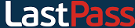
Some Current Existing Password Managers
LastPass
Dashlane
KeePass
1Password
1001010100110010100010100010101011001001111001010101010100110
Strengths: User friendly, multi-factor authentication, strong encryption
Weaknesses: Has experienced multiple data breaches
Strengths: Offers multiple plans for security features (Phishing alerts, dark web insights, etc)
Weaknesses: More limited storage and inability to customize and organize
Strengths: Portable and installation is not required. Can be carried on a USB stick and runs on Windows systems. Installer packages available, though
Weaknesses: Not user friendly. Also, security vulnerability found
Strengths: Very easy to use and user friendly. Excellent customer service and an award winning password manager. Strong encryption
Weaknesses: Windows version lacks certain features and functions that are present in the Mac version

Slide 7
Password Manager Research Continued
1001010100110010100010100010101011001001111001010101010100110
LastPass
Dashlane
Background
First password manager to offer a passwordless login
Face or fingerprint ID in the mobile app
Realized people often use the same passwords for everything, so developed a feature that allowed users to identify weak, duplicate passwords within their own storage
Background
Helps users create very creative passwords
Can be used on any device
Allows sharing credentials with other users
Offers different security features like a dark web scan to check for any leaked data and is able to alert employees when sensitive data is involved
1001010100110010100010100010101011001001111001010101010100110

Slide 8
Password Manager Research Continued
1001010100110010100010100010101011001001111001010101010100110
KeePass
1Password
Background Highlights
One master password decrypts the whole database
You can use key files - can carry the key file with you on USB
Can combine to need both the key file AND the password in order to unlock the database
SHA-256 is used to hash the master key components
A 256- bit cryptographically secure one-way hash function
Background Highlights
Award winning customer support
Goal is to make security simple and intuitive
Handles all expected tasks a password manager should
Lots of keyboard shortcuts available
Has two-factor authentication
Lots of different features available like Dashlane
Powered by DuckDuckGo Smarter Encryption

Slide 9
LastPass Data Breaches
1001010100110010100010100010101011001001111001010101010100110
Incidents
Experienced quite a few data breaches so let’s focus on the more recent one
What happened?
Hackers gained access to the system from installing harmful software into an employee’s personal computer which captured their typing activities
LastPass was not very clear on how that happened and did not have direct communication
What was Discovered
Turns out the employee had Plex Media server software that had a known weakness which they communicated back in May 2020 and fixed since then
Plex had already fixed this three years ago, but the LastPass employee ignored all the warnings they gave and never updated their server software to get the fix
Mistakes and Outcomes
The company made another mistake by allowing that employee to use their home computer to access this sensitive data
The outcome was the hacker got a copy of customers’ encrypted password vaults and the un-encrypted data on users’ account info. This includes email addresses as well as phone numbers

Slide 10
Existing Password Managers VS. Mine
Similarities
Differences
10010101001100101000101000101010110010011110010101010101
Uses a master password as a key to your the password vault
Checks for weak passwords
Good design - Notifies users properly and in a concise manner
Prioritizes master password and has strict requirements for a strong one
Zero-Knowledge Architecture
SHA256 Hashing
More limited password sharing feature
Needs to be more careful as this feature could lead to unauthorized access
Transparency
More transparency and active communication with users if incidents occur
Windows and Mac having equal features
Master password always needed and not able to bypass it

Slide 11
Different Ways to Store the Data
Browser-based
Stand-alone
Cloud-based
Built into browsers
Stored locally
Convenient and easy to use
Only basic functionality
Vulnerable to browser exploits
No 2FA
Dedicated applications designed to store passwords
Offers more features
Requires master password
More secure
Requires installation
Some have fees
Store databases on remote servers
Encrypted locally before uploaded to cloud
Can access on any device
Advanced Security features
Need Cloud provider
Targeted by hackers

Slide 12
Baseline Program
Before Database Implementation:
Account
Menu
- title : string
- message : string
- userInputString : string
- userID : string
- stringHash : string
- usernameHash : string
- passwordHash : string
- userExists : bool
- account : Account
- title : string
- userID : string
- input : int
- flag : bool
C++/OpenSSL
Password Manager account creation/login
Add account information (site/UN/PW)
View account information stored in Password Manager
users.dat
List of existing user’s hashed UN/PW
user_data/<uid>.dat
List of account information
Makefile
+ Menu() :
+ ~Menu() :
+ mainMenu() : bool
+ accountMenu(uid : string) : bool
+ Account() :
+ ~Account() :
+ createAccount() : bool
+ hashString(unhashedString : string) : string
+ checkExistingUsers(usernameHash : string) : bool
+ getUserID(usernameHash : string) : string
+ createHash(unhashedString : string) : string
+ isUserValid(usernameHash : string, passwordHash : string) : bool
+ authenticateUser() : string
Manager
- title : string
- userID : string
- input : int
- flag : bool
Crypto
+ Manager() :
+ ~Manager() :
+ getInput() : string
+ viewPasswords(uid : string) : void
+ addPassword(uid : string) : void
+ Crypto() :
+ ~Crypto():
+ generateHash(unhashedString : string) : string

Slide 13
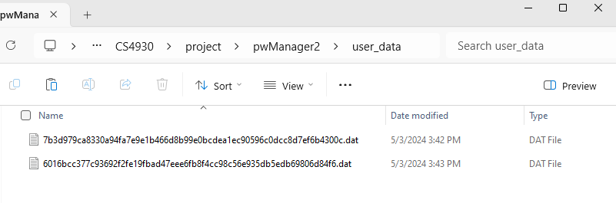
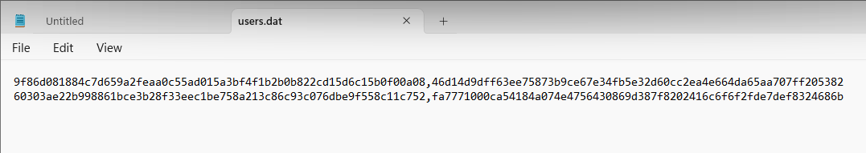
Baseline Program
10010101001100101000101000101010110010011110010101010101

Slide 14
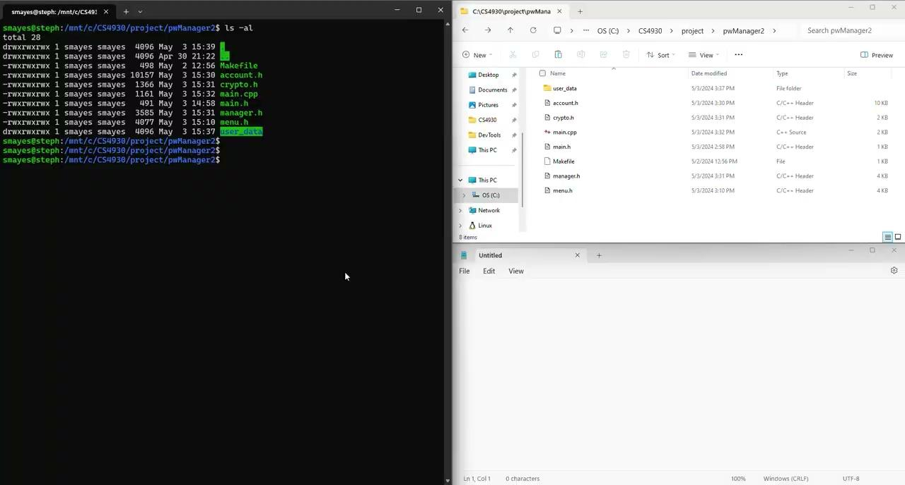
Baseline Program
Demo Video
10010101001100101000101000101010110010011110010101010101

Slide 15

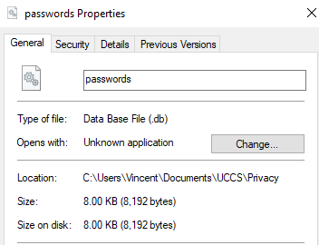
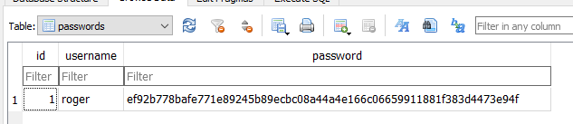
Database
Implementation
On its own at first
Used sqlite
Would have used secure database SQLCipher but expensive
Creates database locally
Stores encrypted password
Is accessed and decrypted using openssl

Slide 16

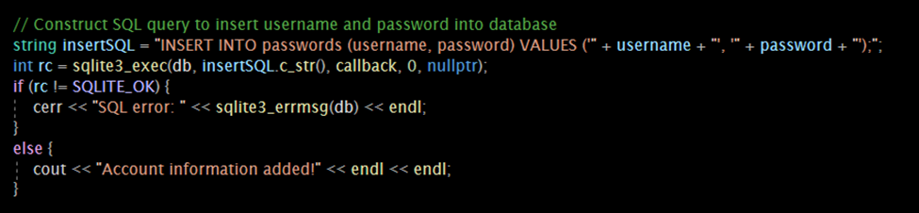
Putting the parts together
Main code and the database
Had different iterations,
Documentation is important
Created new project for combining the code
Went through each file that changed data and added sqlite code
Wanted to practice working in industry. Working on separate parts and combining for a final product

Slide 17
Challenges
Baseline Program:
GUI creation – C++ doesn’t have many great options
Linking errors with OpenSSL – makefile was the problem
Encryption for each file – shifted to database encryption instead for simplicity
Database:
Secure storage
File linkage in MVS
For the Future
Potential added features
2-factor authentication along with master password
Secure password sharing
Alert when database is accessed
GUI implementation

Slide 18
Resources
Features available in each Dashlane App. (n.d.). https://support.dashlane.com/hc/en-us/articles/360017489860-Features-available-in-each-Dashlane-app
Dashlane. (2024, January 16). How password managers work: A beginner’s guide. https://www.dashlane.com/blog/how-password-managers-work-beginners-guide
Toubba, K. (n.d.). Security incident March 2023 Update & Actions - LastPass - the LastPass blog. The LastPass Blog - The Last Password You’ll Ever Need. https://blog.lastpass.com/posts/2023/03/security-incident-update-recommended-actions
Alodhyani, F., Theodorakopoulos, G., & Reinecke, P. (2020, October 30). Password managers-it’s All About Trust and Transparency. MDPI. https://www.mdpi.com/1999-5903/12/11/189
Rees, K. (2023, November 8). How many times has lastpass been hacked, and is it still safe to use?. MUO. https://www.makeuseof.com/how-many-times-lastpass-hacked/
Walters, M. (2023, December 8). Lastpass breach reveals important lessons. Dark Reading. https://www.darkreading.com/cyberattacks-data-breaches/lastpass-breach-reveals-important-lessons
What is Dashlane? – dashlane. (n.d.-b). https://support.dashlane.com/hc/en-us/articles/4679936285458-What-is-Dashlane-

